Slide 1


K.RAMAKRISHNAN COLLEGE OF TECHNOLOGY (AUTONOMOUS), TRICHY
ANALYSING PATTERNS IN LOAN DATA USING LOGISTIC REGRESSION
PRESENTED BY
SATHIYASEELAN A - ADB23099

Slide 2
PRESENTATION OVERVIEW
Problem Identification and Analysis
Objective
Proposed Work Architecture & Module Design
Block diagram of proposed system
Module Description
Module Implementation
R Programming Implementation
Source Code
Output Snapshots
Conclusion

Slide 3
PROBLEM IDENTIFICATION
Problem Identification
Manual process – Time-consuming and error-prone loan approvals.
No data insights – Hidden patterns in loan data remain unexplored.
Inconsistent decisions – Varying judgment leads to unfair outcome.
No predictions – Lacks tools to forecast loan approval status..
Problem Analysis
Multiple influencing factors – Loan decisions depend on many variables like income, credit history, and employment.
Missing/incomplete data – Real-world datasets often have gaps needing preprocessing.
Need for automation – Manual analysis is inefficient for large datasets.

Slide 4
OBJECTIVE
To develop a predictive model using logistic regression that classifies loan applications as approved or rejected based on historical data.
To preprocess and clean loan datasets by handling missing values and generating new derived features to improve model accuracy.
To identify and visualize key factors influencing loan approval decisions through feature importance and statistical summaries.
To create a user-friendly Shiny application that allows users to upload data, train models, and view performance metrics like confusion matrix and ROC curve.

Slide 5
Proposed Work Architecture & Module Design
Data Upload - User uploads loan dataset (.csv) via the Shiny interface.
Data Preprocessing - Cleans missing values, converts data types, and creates new features
Feature Selection - User selects input features to be used in logistic regression modeling.
Model Training - Builds a logistic regression model using selected features to predict loan approval (Loan_Status).
Model Evaluation - Displays:Confusion Matrix for accuracy,Model Summary (coefficients, p-values),ROC Curve & AUC for performance.
Visualization ModuleShows - Sample data view,Feature importance plot,ROC curve plot.

Slide 6
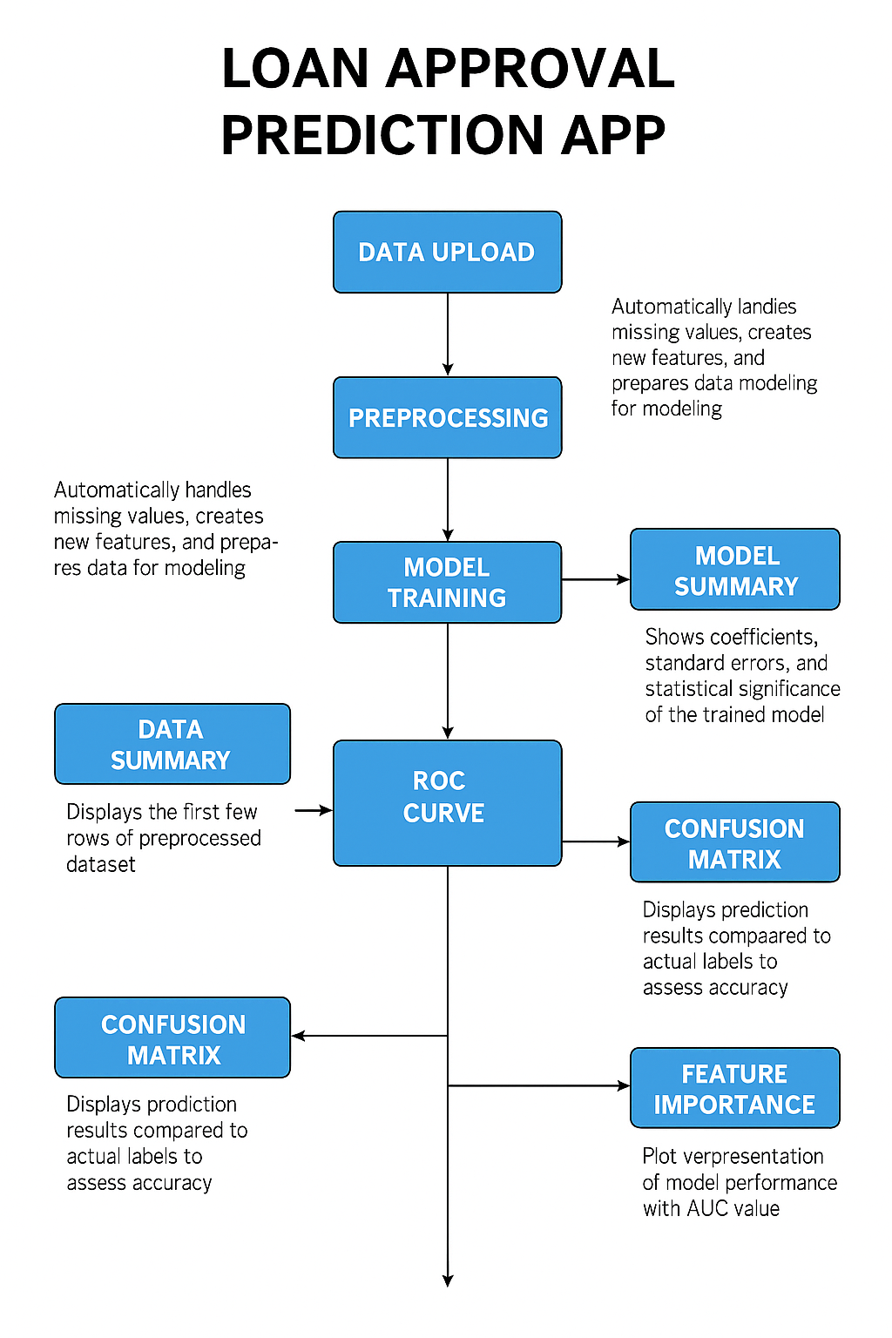
BLOCK DIAGRAM

Slide 7
MODULES DESCRIPTION
1. Data Import
2. Data Processing
3. Model Training
4. Confusion Matrix Analysis
5. ROC Curve
6. Feature Importance Plots

Slide 8
MODULE IMPLEMENTATION
1. Data Import
Upload the loan dataset in .csv format using fileInput() in Shiny.
Read the data using read.csv().
Store it as a reactive object for further processing.
2. Data Processing
Handle missing values (e.g., using replace_na()).
Convert character columns to factors for modeling
Remove unnecessary columns like Loan_ID.

Slide 9
MODULE IMPLEMENTATION
3. Model Training
Use glm() to train a logistic regression model.
The formula is dynamically built using selected features from checkboxGroupInput.
Model is trained to predict Loan_Status (Y/N).
4. Confusion Matrix Analysis
Use predict() to get model predictions.
Convert probabilities to class labels (ifelse(prob > 0.5, "Y", "N")).
Generate a confusion matrix using confusionMatrix() from the caret package.

Slide 10
MODULE IMPLEMENTATION
5. ROC Curve
Use pROC::roc() to compute the ROC curve.
Plot the curve using plot() with AUC shown.
Helps evaluate model’s ability to distinguish between approved and rejected loans.
6. Feature Importance Plots
Extract model coefficients using summary(model)$coefficients.
Visualize feature effects using ggplot2 (geom_col()).
Sort features by absolute effect size to highlight most influential variables.

Slide 11
R PROGRAMMING IMPLEMENTATION
The system is built using R Shiny with a dashboard layout styled using bslib, shinydashboard, and shinyjs.
Data processing is handled using dplyr.
Visuals are built using plotly for interactivity and clarity.
The app includes:
- Login panel with basic authentication
- Dashboard for analysis
- Upload panel for CSV files
- Prediction page with recommendation logic

Slide 12
SOURCE CODE
library(shiny)
library(tidyverse)
library(caret)
library(pROC)
ui <- fluidPage(
titlePanel("Loan Approval Prediction with Logistic Regression"),
sidebarLayout(
sidebarPanel(
fileInput("file", "Upload Loan Data CSV", accept = ".csv"),
checkboxGroupInput("features", "Select Features", choices = NULL),
actionButton("trainModel", "Train Model")
),
mainPanel(
tabsetPanel(
tabPanel("Data Summary", tableOutput("dataSummary")),
tabPanel("Model Summary", verbatimTextOutput("modelSummary")),
tabPanel("Confusion Matrix", verbatimTextOutput("confMatrix")),
tabPanel("ROC Curve", plotOutput("rocPlot")),
tabPanel("Feature Importance", plotOutput("featurePlot"))
)
)
)
)
server <- function(input, output, session) {
data <- reactive({
req(input$file)
df <- read.csv(input$file$datapath)
# Preprocessing
df <- df %>%
mutate(
Gender = replace_na(Gender, "Male"),
Married = replace_na(Married, "Yes"),
Dependents = replace_na(Dependents, "0"),
Self_Employed = replace_na(Self_Employed, "No"),
Credit_History = replace_na(Credit_History, 1),
LoanAmount = replace_na(LoanAmount, median(LoanAmount, na.rm = TRUE)),
Loan_Amount_Term = replace_na(Loan_Amount_Term, 360),
TotalIncome = ApplicantIncome + CoapplicantIncome,
EMI = LoanAmount / Loan_Amount_Term,
BalanceIncome = TotalIncome - (EMI * 1000)) %>%

Slide 13
SOURCE CODE
mutate(across(where(is.character), as.factor)) %>%
select(-Loan_ID)
return(df)
})
observe({
updateCheckboxGroupInput(session, "features", choices = names(data())[!names(data()) %in% c("Loan_Status")])
})
model <- eventReactive(input$trainModel, {
df <- data()
form <- as.formula(paste("Loan_Status ~", paste(input$features, collapse = "+")))
glm(form, data = df, family = "binomial")
})
output$dataSummary <- renderTable({
head(data())
})
output$modelSummary <- renderPrint({
summary(model())
})
output$confMatrix <- renderPrint({
df <- data()
prob <- predict(model(), newdata = df, type = "response")
pred <- ifelse(prob > 0.5, "Y", "N")
confusionMatrix(as.factor(pred), df$Loan_Status)
})
output$rocPlot <- renderPlot({
df <- data()
prob <- predict(model(), newdata = df, type = "response")
roc_obj <- roc(df$Loan_Status, prob)
plot(roc_obj, col = "blue", main = paste("ROC Curve (AUC =", round(auc(roc_obj), 2), ")"))
})
output$featurePlot <- renderPlot({
coef_df <- as.data.frame(summary(model())$coefficients)
coef_df$Feature <- rownames(coef_df)
coef_df <- coef_df %>% filter(Feature != "(Intercept)")
ggplot(coef_df, aes(x = reorder(Feature, abs(Estimate)), y = Estimate)) +
geom_col(fill = "darkgreen") +
coord_flip() +
theme_minimal() +
labs(title = "Feature Importance", x = "Feature", y = "Estimate")
})
}
shinyApp(ui = ui, server = server)

Slide 14
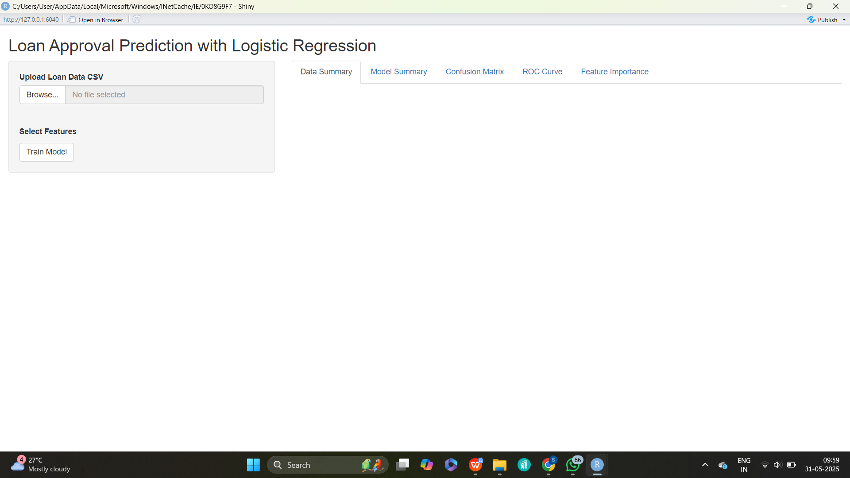
Output Snapshots

Slide 15
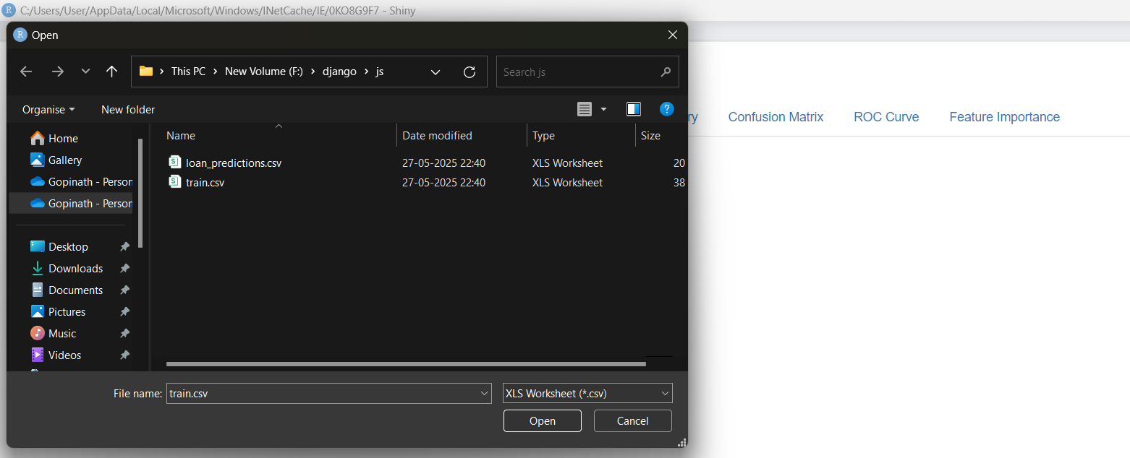
Output Snapshots

Slide 16
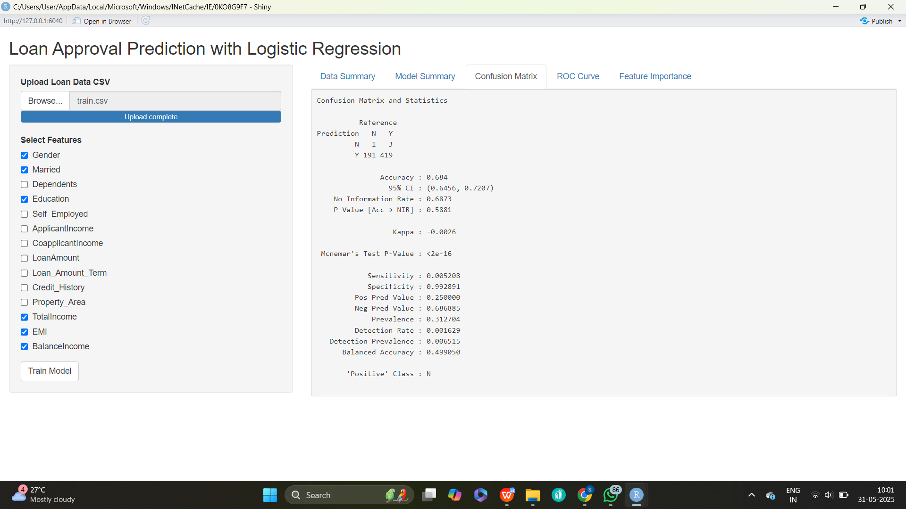
Output Snapshots

Slide 17
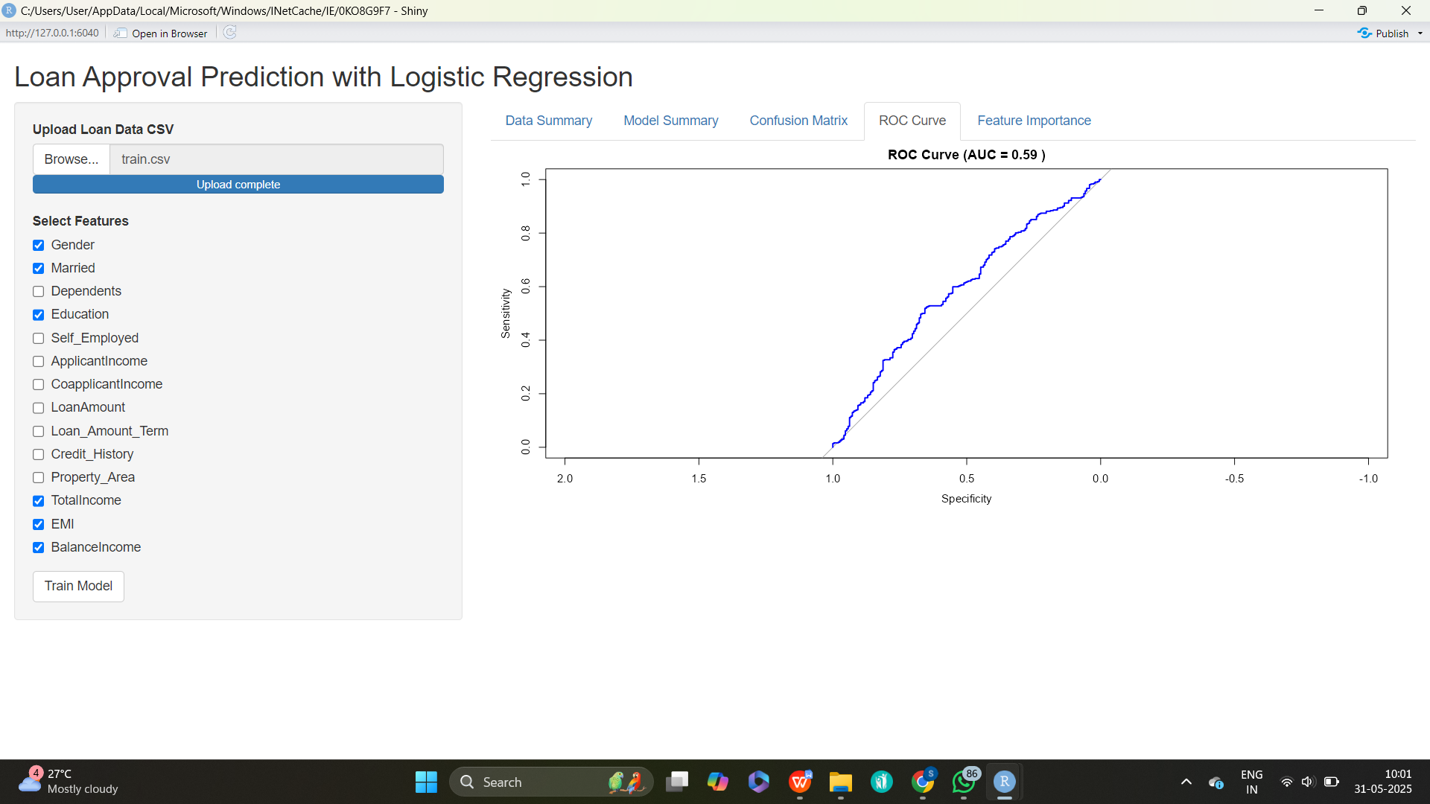
Output Snapshots

Slide 18
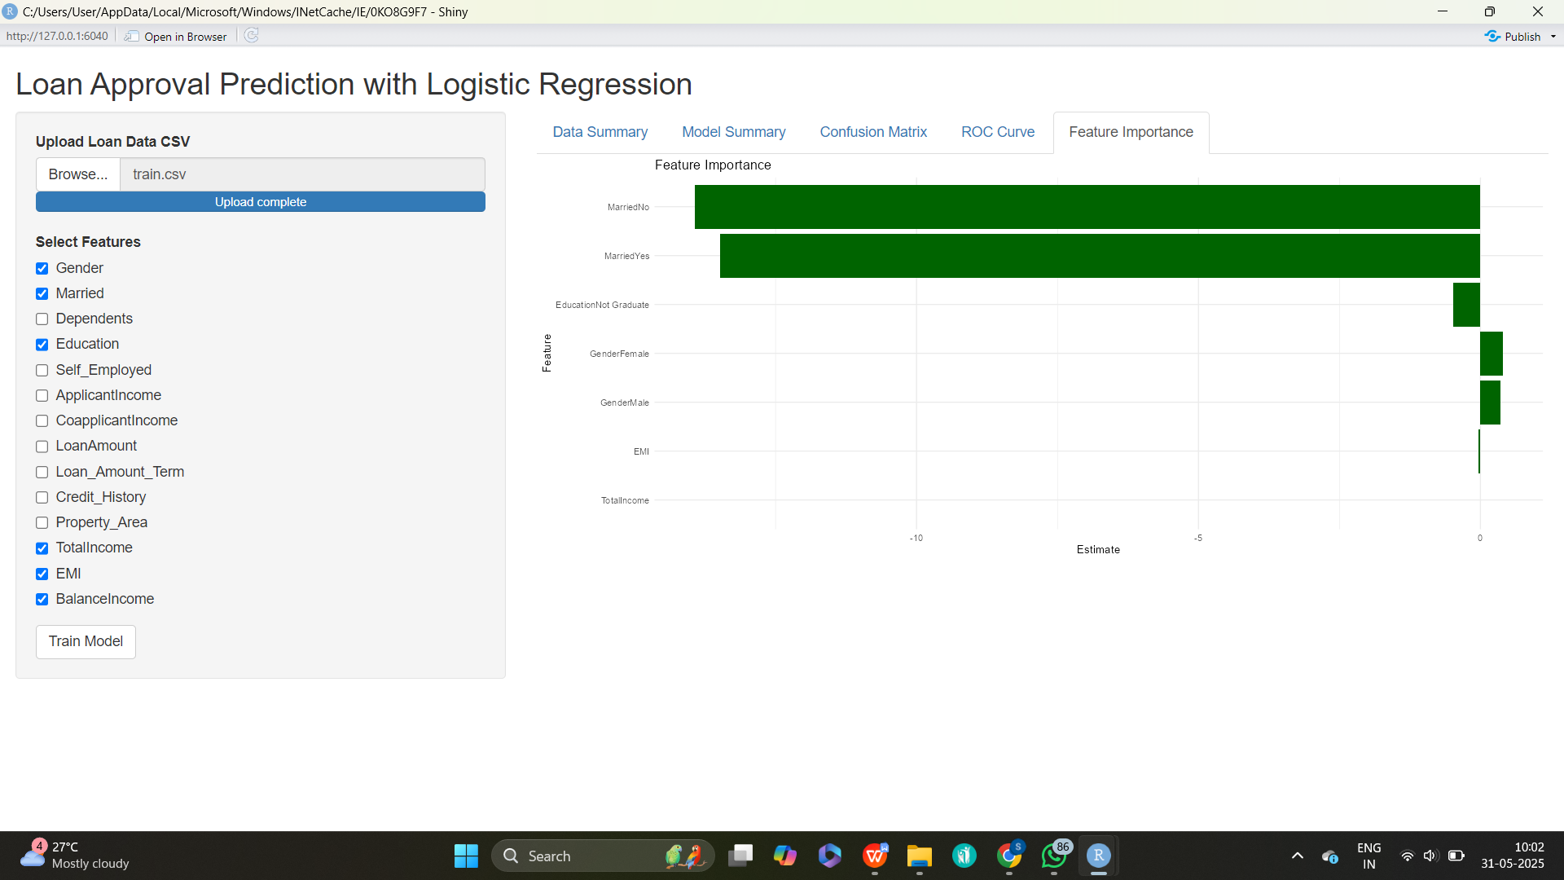
Output Snapshots

Slide 19
CONCLUSION
Logistic Regression effectively predicts loan approval outcomes.
Key influencing factors: income, loan amount, credit history, employment status.
The model is simple, interpretable, and performs well for binary classification.
Future Scope:
Use advanced models (e.g., Random Forest, XGBoost) for higher accuracy.
Add more detailed features (e.g., credit score, spending habits).
Deploy as a real-time loan eligibility tool.

Slide 20
THANK YOU

